Slide 1
Enterprise Systems Research Group
Who we are and what we do

Slide 2
Overview
Founded in January 2009
Focuses on unique technical and socio-technical challenges involved in
analysis, design, implementation, deployment and management of enterprise systems,
as well as adaptive, and autonomous systems
Notes:
Enterprise systems are large-scale, distributed, highly complex, and business-critical software systems that extend across and between organizations

Slide 3
Overview - Research Areas
Model driven engineering (MDE)
Model transformation, model validation and verification
Adaptive and autonomous systems and processes
Model checking for adaptive, autonomous, secure and dependable systems
Runtime formal specification, modelling and verification
Cloud computing
Software verification and validation
Notes:
MDE: is a model-based development approach of software, where models as first-class artefacts are being manipulated, managed, transformed and verified.

Slide 4


Current Funded Research Projects
European Commission; Horizon 2020 Programme
TYPHON (2018-2020)
CROSSMINE (2017-2019)
The Innovate UK
Knowledge Transfer Partnership with IBM, Smith & Nephew, and Rolls-Royce (2017-2021)
SECT-AIR (2016-2019)
Notes:
EC is an big institution of the European Union that has a lot of responsibilities and one of them is proposing and implementing the EU budget and managing EU funding programmes such as Horizon 2020 Programme and more.
Innovate UK is a non-departmental public body, and it is sponsored by the Department for Business, Energy & Industrial Strategy.
TYPHON: on ybrid persistence architectures for Big Data analytics
CROSSMINE: knowledge extraction from open-source software
Knowledge Transfer Partnership:
1. IBM on applications of MDE technologies in the data management domain,
2. Smith & Nephew on applications of MDE technologies in the medical device domain,
3. on domain-specific modelling and model-based engineering of aerospace systems
SECT-AIR is a project founded by Innovate UK and UK aerospace industry

Slide 5

Current Funded Research Projects
The Defence Science and Technology Laboratory (DSTL)
Continuous Planning of Operational Processes Applied to Non-combatant
Evacuation Operations (2017-2018)
Continual Analysis of Operational Process Dependability (2014-2018)
Assured Reinforcement Learning for Safety-Critical Applications (2013-2018)
Notes:
Dstl is an agency sponsored by the Ministry of Defence of UK

Slide 6



Current Funded Research Projects
ESRC National Productivity Investment Fund (2017-2018)
Economic and Social Research Council
Integrated correctness analysis and performance evaluation (2017-2021)
Microsoft Research
Assurance of Deep-Learning AI Techniques (2018-2021)
Lloyd’s Register Foundation
Notes:
ESRC is one of the seven Research Councils in the United Kingdom. It receives most of its funding from the Department for Business, Innovation and Skills. The project we have is a collaborative project with Keyfort on delivery of mental health support services through mobile apps

Slide 7
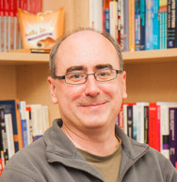
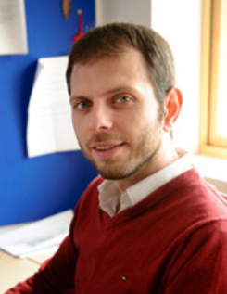
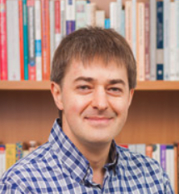
Group Members: Academic Staff
Prof. Richard Paige Deputy head of department (Research) ES group leader | Prof. Dimitris Kolovos MSc & EngD LSCITS Director | Dr. Radu Calinescu TASP leader
Notes:
LSCITS: Large Scale Complex IT Systems
TASP: Trustworthy Adaptive and Autonomous Systems & Processes

Slide 8

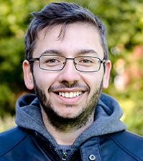
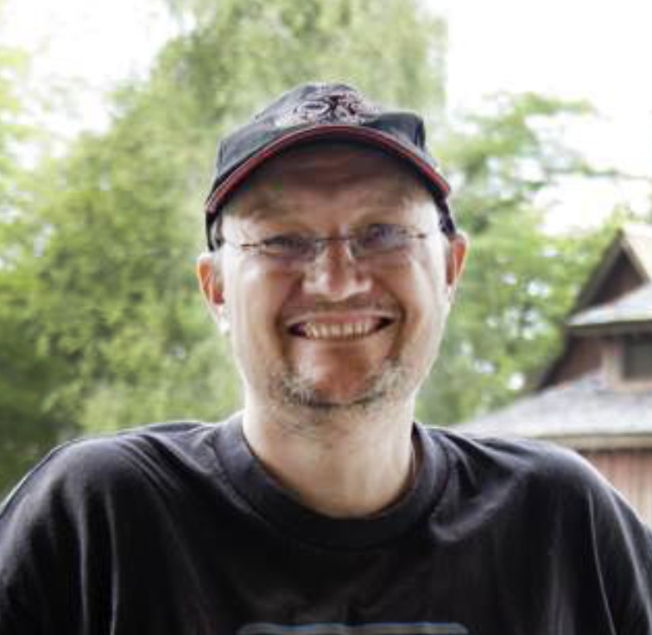
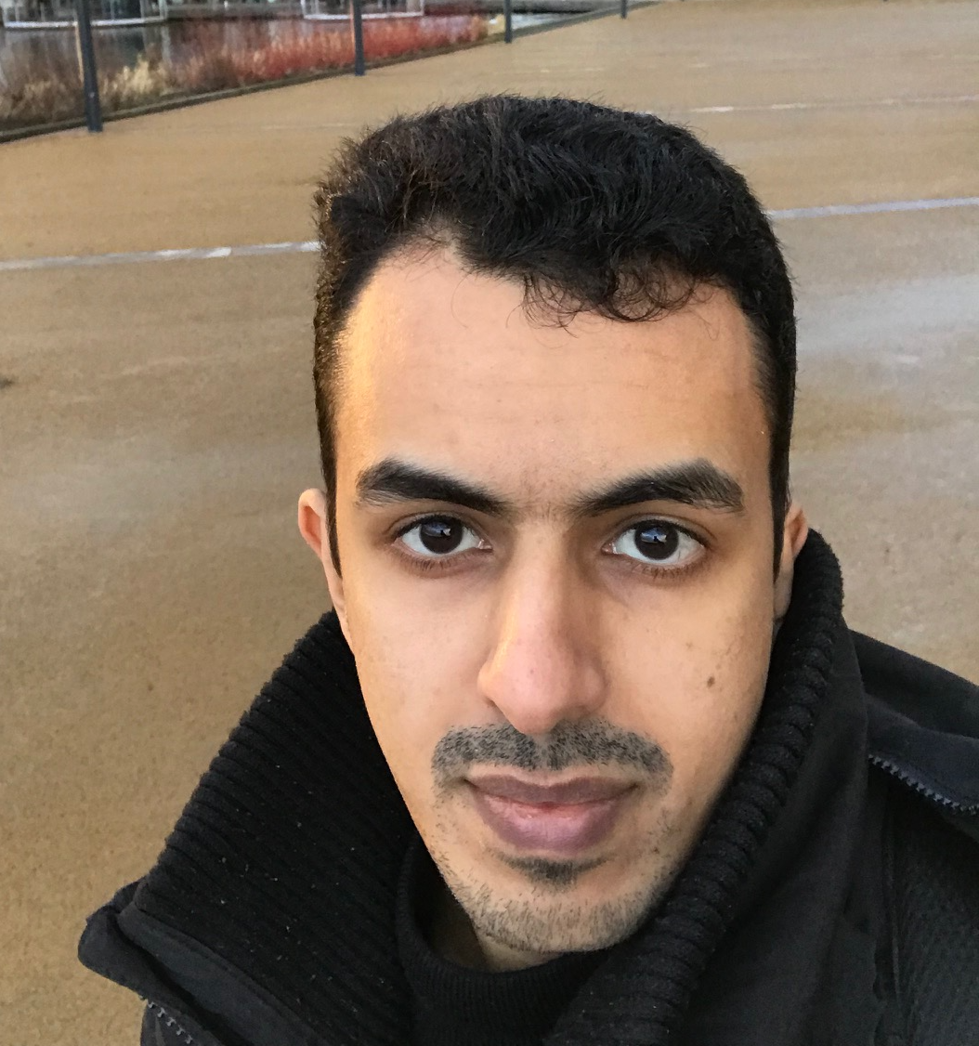
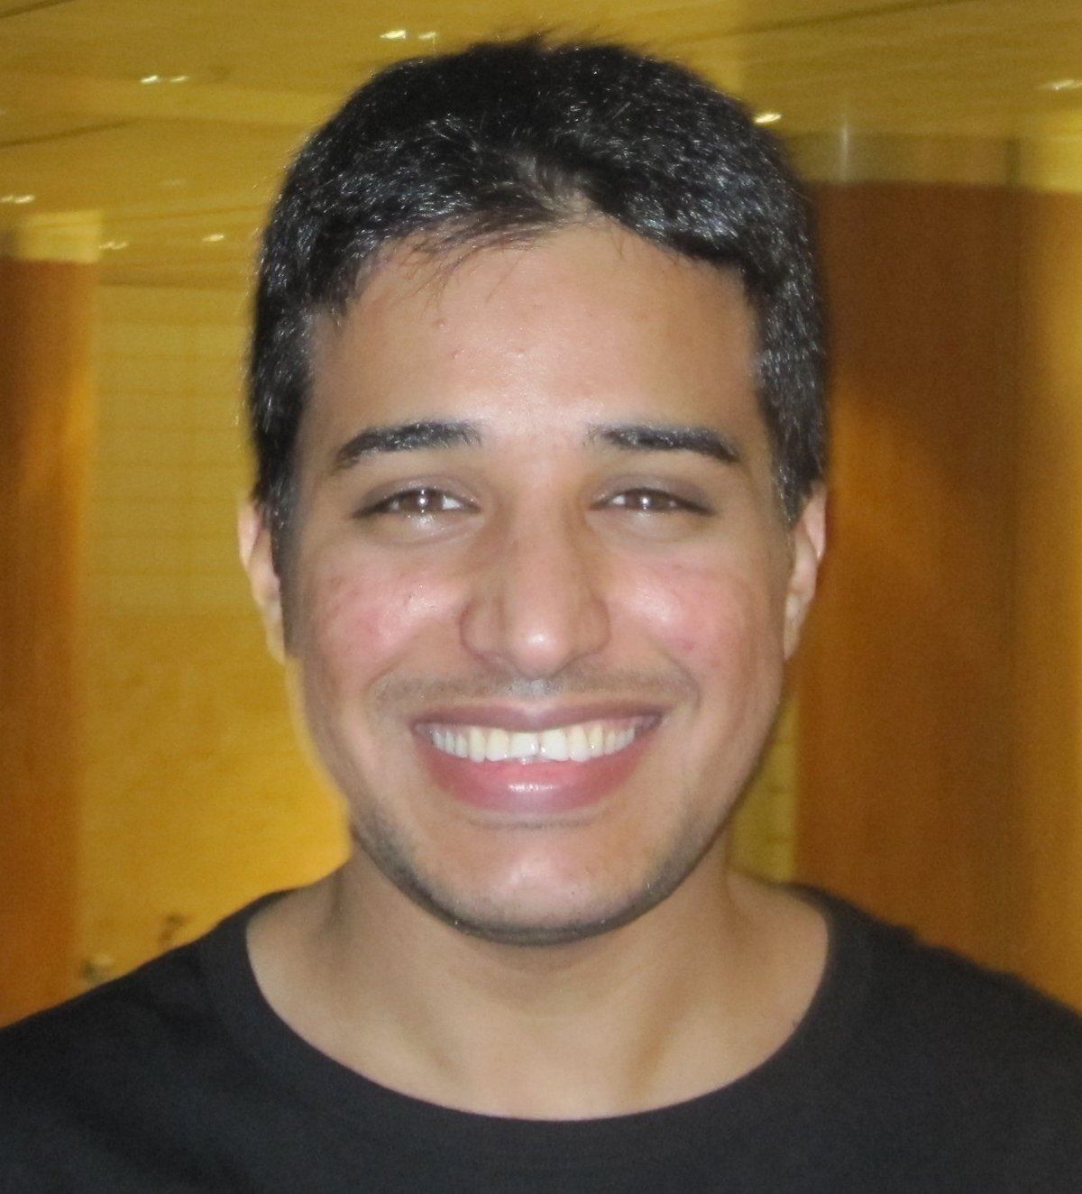
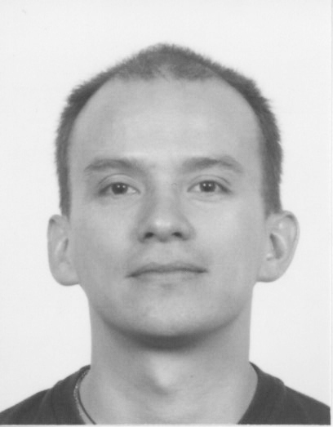
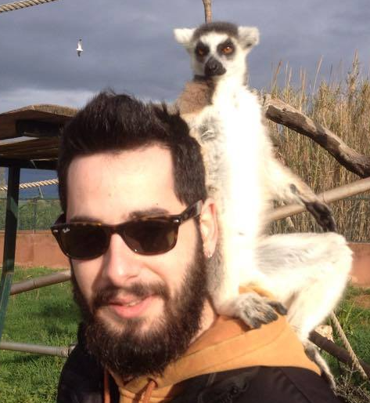
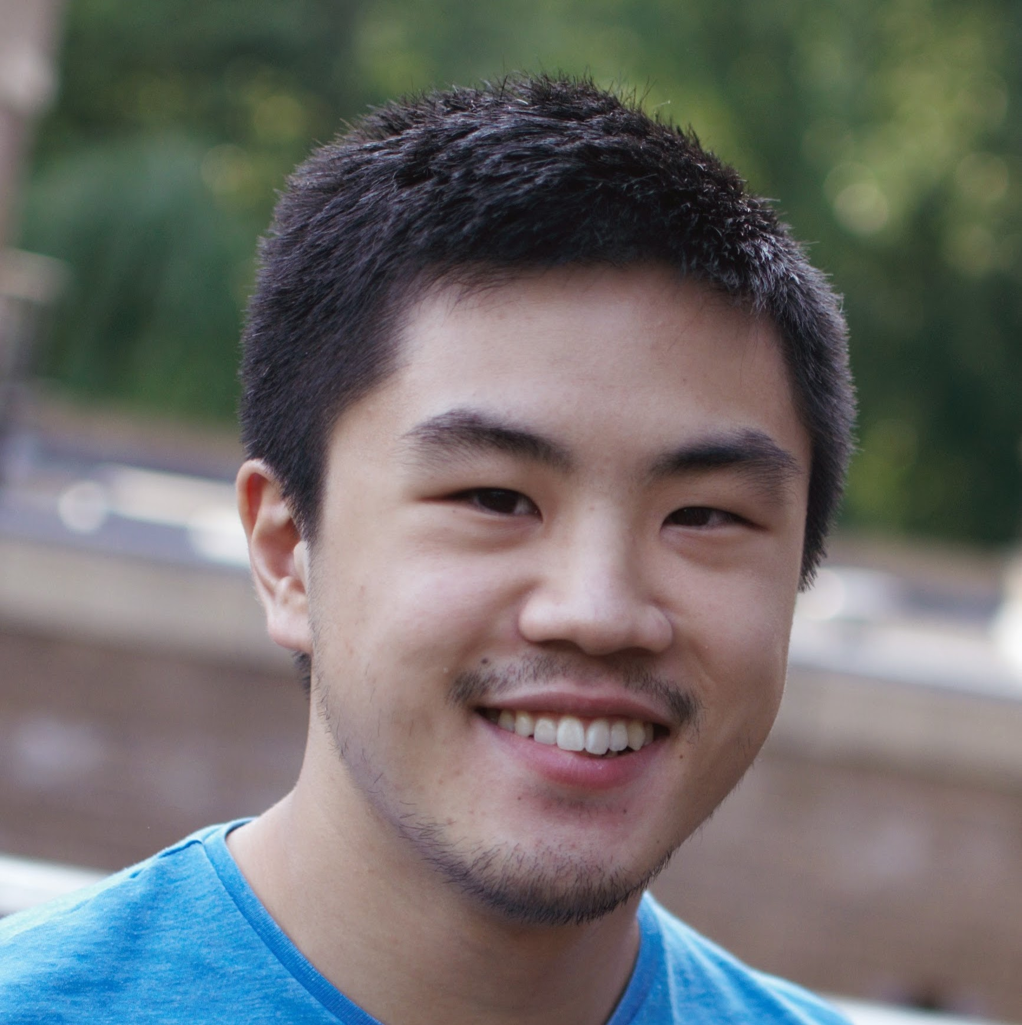
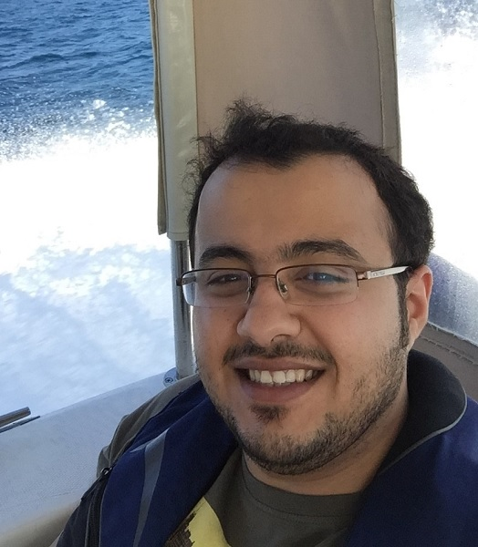
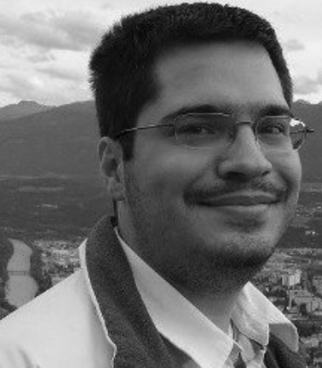
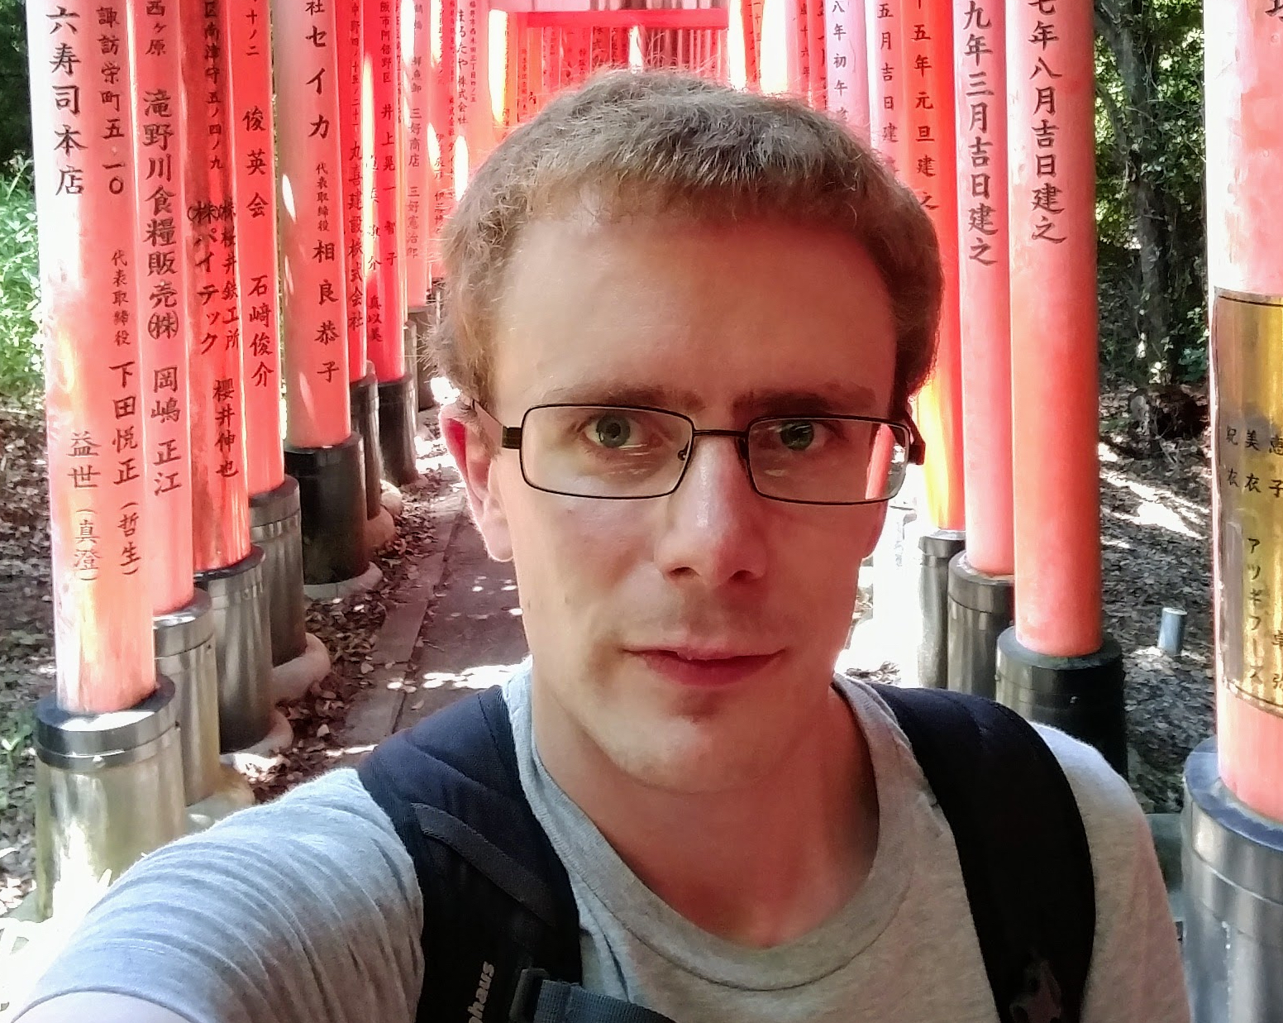
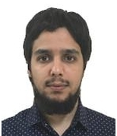
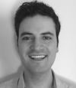
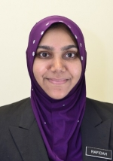
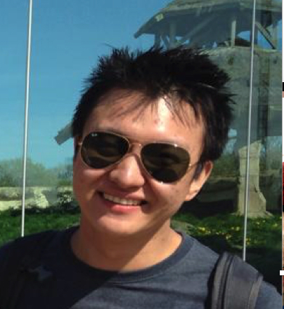
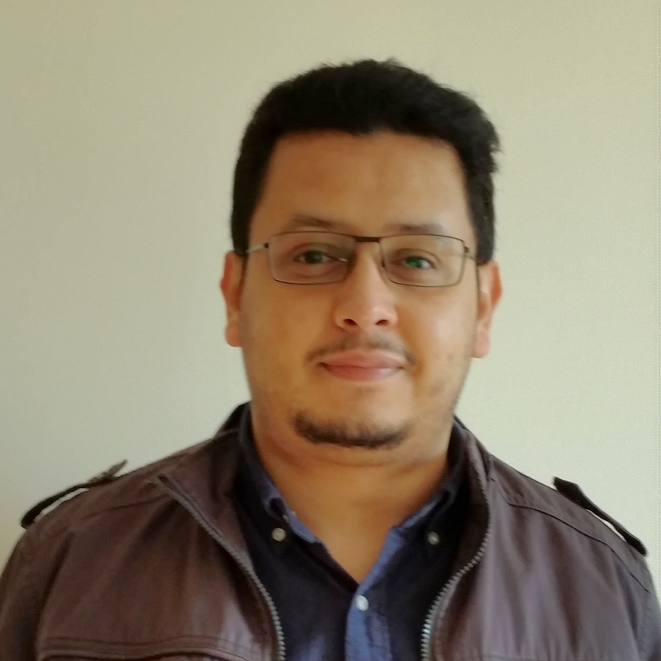
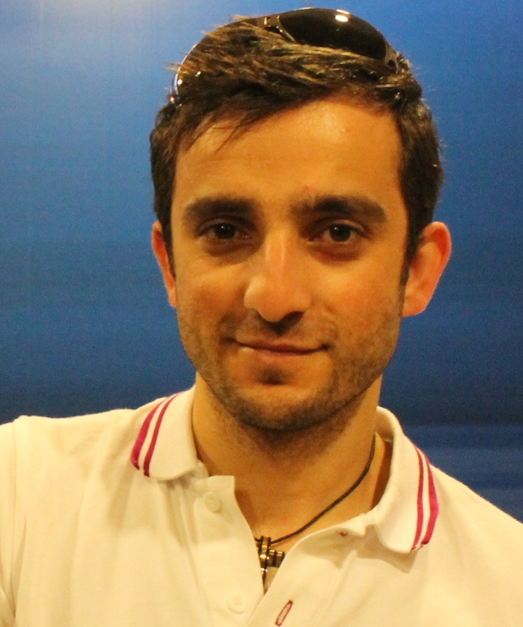
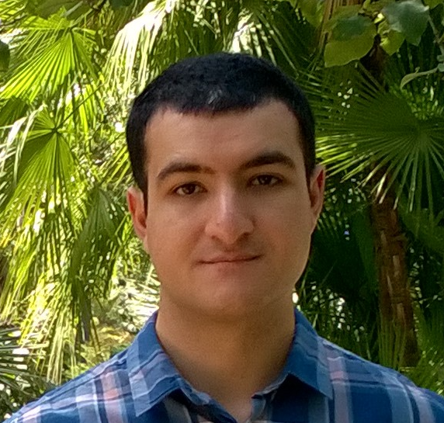
Group Members: RAs & RSs
Abdullah Albalawi | Athanasios Zolotas | Bestoon Hussien | Colin Paterson | Emad Alharbi | Faisal Alhwikem | George Mason
Horacio H. Rodriguez | Ioannis Stefanakos | Jonathan Co | Khaled Aldheeif | Konstantinos Barmpis | Martyn Ellison | Naif Alasmari
Patrick Neubauer | Rafidah P. Mohamad | Ran Wei | Saud Yonbawi | Simos Gerasimou | Sina Madani

Slide 9
Group Seminars
Run every Monday from 12:30 to 13:30 in RCH/102e
Host talks given by group members and visitors
Host research students seminars: Literature Review Seminars and Thesis Seminars
Rehearse presentations and provide feedback
Paper reviews, assessment and discussion
SCRUM
Organiser: Faisal Alhwikem (faisal@cs.york.ac.uk)
Notes:
SCRUM: is a meeting that we do periodically where each group member gives an update of his/her current/recent research/project challenges and discuss ways to tackle them.

